Slide 1
Approximation Algorithm
Algorithm : Design & Analysis
[22]

Slide 2
In the Last Class…
Bounds of NP-Completeness
Proving NPC by Reduction
Examples of Reduction
  Max Clique
  Hamiltonian Graph
  Subset Sum and Job Scheduling

Slide 3
Approximation Algorithm
Conquer the Complexity by Approximation
Approximation Algorithm for Bin Packing
Evaluate an Approximation Algorithm
Online algorithm

Slide 4
Conquer the Complexity
Challenge: more than often, the problem with important practical background is NPC.
Good algorithm in “general sense: functionally perfection and efficiency
Not perfect, but efficiency: approximation
Low probability input ignored: probability

Slide 5
Bin Packing Problem
Suppose we have an unlimited number of bins each of capacity one, and n objects with sizes s₁, s₂, …, s_{n} where 0<s_{i}≤1 (s_{i} are rational numbers)
Optimization problem: Determine the smallest number of bins into which the objects can be packets (and find an optimal packing) .
Bin packing is a NPC problem

Slide 6
Feasible Solution
For any given input I={s₁,s₂,…,s_{n}}, the feasible solution set, FS(I) is the set of all valid packings using any number of bins.
In other words, that is the set of all partitions of I into disjoint subsets T₁,T₂,…,T_{p}, for some p, such that the total of the s_{i} in any subset is at most 1.

Slide 7
Optimal Solution
In the bin packing problem, the optimization parameter is the number of bins used.
For any given input I and a feasible solution x, val(I,x) is the value of the optimization parameter.
For a given input I, the optimum value, opt(I)=min{val(I,x) | x∈FS(I)}
An optimal solution for I is a feasible solution which achieves the optimum value.

Slide 8
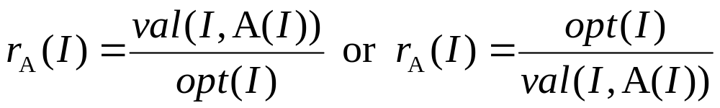
Approximation Algorithm
An approximation algorithm A for a problem is a polynomial-time algorithm that, when given input I, output an element of FS(I).
Quality of an approximation algorithm(min or max).
R_{A}(m) = max {r_{A}(I) | I such that opt(I)=m}
For an approximation algorithm, we hope the value of R_{A}(m) is bounded by small constants.

Slide 9
First Fit Decreasing - FFD
The strategy: packing the largest as possible
Example: S=(0.8, 0.5, 0.4, 0.4, 0.3, 0.2, 0.2, 0.2)
B₁
B₂
B₃
B₄
0.2(s₆)
0.4(s₃)
0.2(s₇)
0.3(s₅)
0.8(s₁)
0.5(s₂)
0.4(s₄)
0.2(s₈)
This is NOT an optimal solution!

Slide 10
The Procedure
binpackFFD(S, n, bin) //bin is filled and output, object i is packed in bin[i]
float[] used=new float[n+1]; //used[j] is the occupied space in bin j
int i,j;
<initialize all used entries to 0.0>
<sort S into nonincreasing order> // in S after sorted
for (i=1; i≤n; i++)
for (j=1; j≤n; j++)
if (used[j]+S[i]≤1.0)
bin[i]=j;
used[j]+=S[i];
break;
in O(nlogn)
i, at most
so, n²/2

Slide 11
Small Objects in Extra Bins
Let S={s₁, s₂, …, s_{n}} be an input, in nonincreasing order, for the bin packing problem and let opt(S) be the minimum number of bins for S. All of the objects placed by FFD in the extra bins have size at most 1/3.
Let i be the index of the first object placed by FFD in bin opt(S)+1. What we have to do for the proof is: s_{i}≤1/3.

Slide 12
What about a s_{i} larger than 1/3?
[S is sorted] The s₁,s₂,…,s_{i-1} are all larger than 1/3.
So, bin B_{j} for j=1,…,opt(S) contain at most 2 objects each.
Then, for some k≥0, the first k bins contain one object each and the remaining opt(S)-k bins contain two each.
  Proof: no situation (that is, some bin containing 2 objects has a smaller index than some bin containing only one object) as the following is possible
Then: we must have:
t>v, u>s_{i}, so v+s_{i}<1, no extra bin is needed!
u
s_{i}
t
v
B_{p}
p<q
B_{q}

Slide 13
View when Considering s_{i}
s₁
…
…
s_{k}
B₁
B_{k}
B_{k+1}
B_{opt(S)}
So, in any optimal solution, there will be k bins that do not contain any of the objects k+1,…, i.
containing 2 objects each

Slide 14
Contradicting at Last!
Any optimal solution use only opt(S) bins.
However, there are k bins that do not contain any of the objects k+1, …, i-1, i. k+1,…, i-1 must occupy opt(S)-k bins, with each bin containing 2.
Since all objects down through to s_{i} are larger than 1/3, s_{i} can not fit in any of the opt(S)-k bins.
So, extra bin needed, and contradiction.

Slide 15

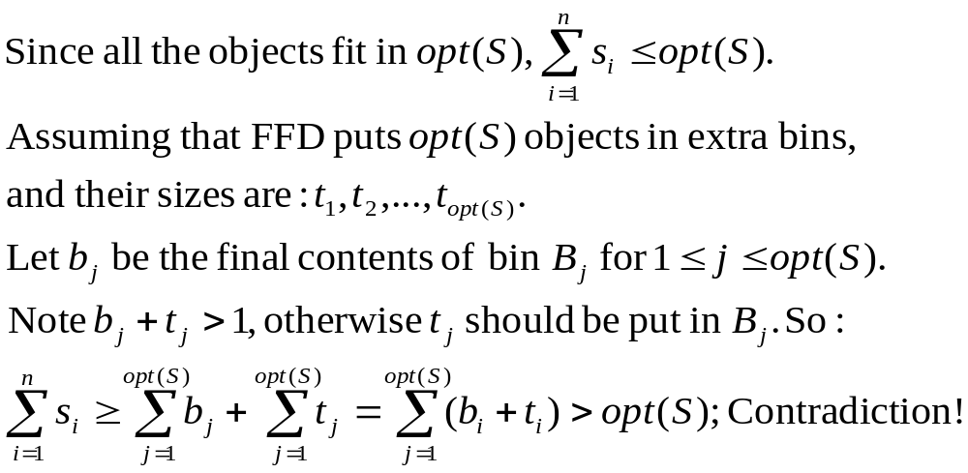
Objects in Extra Bins is Bounded
For any input S={s₁, s₂,…,s_{n}}, the number of objects placed by FFD in extra bins is at most opt(S)-1.

Slide 16
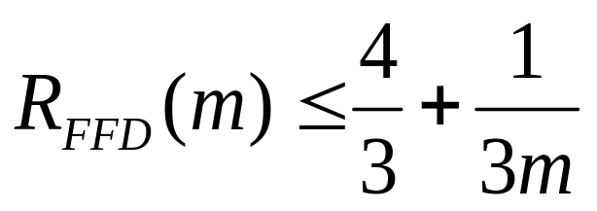
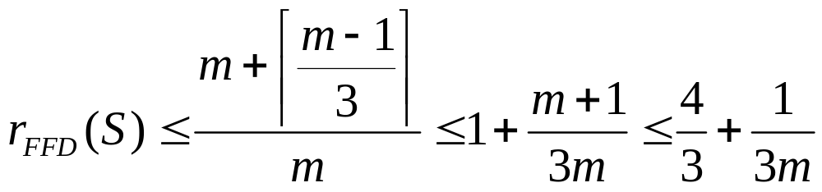
A Good Approximation
Using FFD, the number of bins used is at most about 1/3 more than optimal value.
FFD puts at most m-1 objects in extra bins, and the size of the m-1 object are at most 1/3 each, so, FFD uses at most ⎡(m-1)/3⎤ extra bins.

Slide 17
Average Performance Is Much Better
Empirical Studies on large inputs.
The number of extra bins are estimated by the amount of empty space in the packings produced by the algorithm.
It has been shown that for n objects with sizes uniformly distributed between zero and one, the expected amount of empty space in packings by FFD is approximately 0.3√n.

Slide 18
Online Algorithm
The entries are input one by one, which means that the algorithm never knows when the input will end before it ends.
For the bin packing, each item must be placed in a bin before the next item can be processed.
Since the input may put up the end at any time, so, any optimal solution should be optimal at any time on the processed input.

Slide 19
Challenge for Online Algorithm
Even though unlimited computation is allowed, an online algorithm cannot always give an optimal solution.
  Input 1: n object with the value 0.5- ε each, following by n object with the value 0.5+ε each; (0<ε<0.01)
  Input 2: only n object with the value 0.5-ε each
  No algorithm can give optimal solution for both inputs

Slide 20
Lower Bound for Online Algorithms
Any on-line bin-packing algorithm use at least 4/3 the optimal number of bins for the worst case.
Proof
  Assume that the performance guarantee is better than 4/3. Consider the input S of n items of size ½-ε(0<ε<0.01) followed by n items of size ½+ε. After the nth item is processed, the algorithm uses b bins, and, at the time, the optimal number of bins is n/2. So, 2b/n<4/3, i.e. b/n<2/3;
  However, after all 2n items are processed, the algorithm uses at least 2n-b bins (at most n bins contain 2 items each). So, (2n-b)/n<4/3, which means b/n>2/3, contradiction.

Slide 21
Next Fit Algorithm - NF
The strategy: Put a new item in the last bin if possible, or use a new bin. Never look back!
An example: S={0.2, 0.5, 0.4, 0.7, 0.1, 0.3, 0.8}
0.1
0.5
0.7
0.8
0.4
0.3
0.2

Slide 22
Simple, but Not So Bad
For a given S, if the optimal value is m, NF algorithm uses at most 2m bins.
Proof:
  Note that no two consecutive bins can contain object with total value less than 1, which mean half space is wasted at most.

Slide 23
A Tight Bound for NF
There exists input for which NF uses 2m-2 bins.
An example: The input sequence S consists of n items (n=4k for some integer k). The size of s_{i} for odd i is 0.5 and size of s_{i} for even i is 2/n.
The optimal number of bins is n/4+1(n/4 for 2 of 0.5 each, and 1 for all items with the size 2/n)
NF uses n/2 bins.

Slide 24
First Fit Algorithm - FF
Creating a new bin only when necessary, the algorithm scans all used bins to look for one able to hold a new item.
For the same example: S={0.2, 0.5, 0.4, 0.7, 0.1, 0.3, 0.8}
B₁
B₂
B₃
B₄
0.1
0.3
0.5
0.7
0.8
0.4
0.2
The FF never uses more than ⎡1.7m⎤ bins

Slide 25
Approximate Algorithms
Why approximate algorithms?
What is an approximate algorithm?
  Approximation ratio r_{A}(I)
Online algorithms
  In comparison with traditional algorithms

Slide 26
Home Assignments
pp. 600-
  13.29
  13.31-33

